Slide 1
The Contract Guidelines on Utilization of AI of Japan
September 10, 2020.
Shin Fukuoka

Slide 2
I. Introduction

Slide 3
Introduction
UNCITRAL ^{53rd} Session "Legal issues related to the digital economy - artificial intelligence "
Difficulties in applying existing tort law rules have the potential to disadvantage affected persons, who may suffer harm as a result of the operation of AI systems. In response, proposals have been put forward to establish new liability regimes to better balance the interests of the various actors involved in the use of AI systems. For instance, the Contract Guidelines on Utilization of AI published by the Ministry of Economy, Trade and Industry of Japan notes:
[M]any legal issues regarding the development and utilization of AI-based software, including how to deal with the relationship of rights and who bears liability that might arise in connection to that development and utilization, remain unclarified because these are new issues, and existing legislation is insufficient. In light of these circumstances, there is a pressing need to determine the relationship of rights, attribution of liability, and other similar matters that arise when parties execute contracts.

Slide 4
Introduction
The Contract Guidelines on Utilization of AI includes:
AI software development agreement between venders and users
AI software license agreement (usage subscription) between venders and users
We drafted only a model agreement of the AI software development agreement.
← Wide variation of the AI software license agreement.
The scope of today’s presentation is basically limited to the AI software development agreement.

Slide 5
II. Technical Features of AI Software

Slide 6
Definition of AI
AI (Artificial Intelligence)
Strong AI (general-purpose AI) / Weak AI (specialized AI)
Definition of AI technology
“AI technology”
= A generic term for a series of software technologies that allow computers and other devices to perform the intellectual activities that humans can perform.
In the Guidelines, for the sake of convenience, the term “AI technology” means "one of the learning methods for discovering certain rules in data, and based on those rules, making inferences and predictions about unknown data"

Slide 7
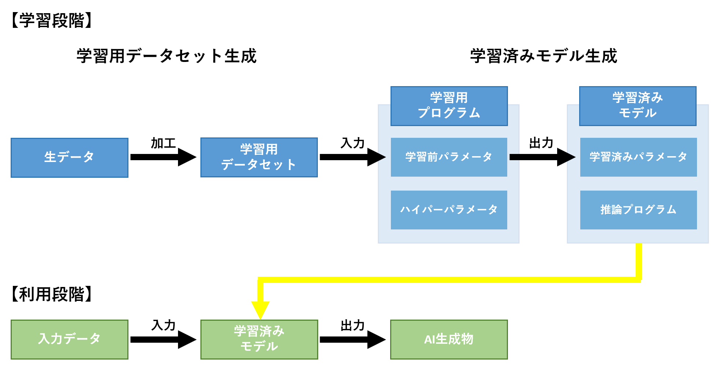
The process of practical application of trained models
Making learning data set
Making Trained Model
Learning program
Trained Model
Untrained Parameters
Trained Parameters
Raw Data
Learning data set
Hyper Parameters
Inference Program
Input Data
Trained Model
AI product

Slide 8
Technical Features of AI Software
Inductive Methods ⇔ Traditional Software: Deductive Methods
  Created from the conclusion (data).
  The output results are a statistical inference based on historical data.
    Difficult to predict 100% of the inferred results of an unknown data input.
  Uncertainty of results
    Depends on the data, so we don't know what the product will look like at the start of development.
Dependence on data ⇒ Importance of data
  Garbage in, garbage out.
  Program itself is commoditized by OSS.
  → Data is a key factor of AI software.

Slide 9
Technical Features of AI Software
  The Importance of Know-How
  How to create a training data set
  Learning methods
  Difficult to conduct ex-post verification
  ・ When generating a trained model, it is often difficult for humans to understand the generation process and the nature of the trained model.
Reuse of trained models
  Can evolve through additional learning.
  Relatively easy to convert to other uses (versatility).

Slide 10
Technical Features of AI Software
Diversification of deliverables
  Traditional IT software:
  (1) Program
  AI software:
  (1) Learning Program
  (2) Data sets for training
  (3) Trained model (inference program + trained parameters)
  (4) Report

Slide 11
AI Differences from Traditional Software
 | Traditional Software | AI Software
Technical characteristics | deductive approach Easy to understand how it works. | inductive approach Difficult to understand how it works.
Development Target Confirmed | easy to do | Difficult in the early days of the contract.
Fixed and guaranteed performance | easy to do | Technical difficulties in guaranteeing performance on unknown input data.
Ex-post verification, etc. | easy to do | difficult to do
Data dependence | low (value) | Content, performance, etc. are dependent on the training data set.
Know-how Importance | high | higher
Demand for learned model reuse | high | higher

Slide 12
III. Practical issues in the AI software development

Slide 13
A Typical Example of AI Software Development
data
existing model
User
Vender
funds
data
know-how
Program (and base model)
work
know-how
(Data)
(Initial parameters)
Trained model

Slide 14
Vendors vs Users in AI software development
Users
Want to own all of the rights related to trained models because they have paid development costs and have provided valuable data and know-how used for training to generate trained models.
Do not want business competitors to use trained models.
Do not want their own data and know-how to be divulged.
Want Vendors to complete and deliver trained models that attain a certain level of quality.
Want to further improve the accuracy of trained models through retraining using their own data.

Slide 15
Vendors vs Users in positions in AI software development
Vendors
Want to ensure business flexibility in their development.
The rights related to software should be owned by the Vendors who develop software.
Want to deploy trained models to other customers.
Want to generate trained models whose accuracy is improved through retraining.
Cannot assure generating a trained model that conforms to the purpose required by a User at the early stage of the development.
Cannot assure performance with respect to completion of trained models and to unknown inputs.

Slide 16
Considerations for the development and use of AI software
Scope of the development and Deliverables
Data Matters
  Quality and sufficiency of data, availability, and delays in provision
  Data protection
Issues related to the AI software product itself
  Whether there is an obligation to complete the AI software
  Performance and quality of AI software
Issues related to intellectual property rights ownership and conditions of use
  Deliverables (trained models, datasets for training)
  Intellectual property arising during development
  Derived model
Liability Issues
  Failure of the development, lack of quality ←(2)
  Accidents
  Infringement of intellectual property rights

Slide 17
Scope of the development and deliverables
Are you clear on the scope to be developed?
A variety of deliverables is produced in the process of AI software development.
  Learning program
  Data sets for training
  (3) Trained model (inference program + trained parameters)
  (4) Derivative models (e.g., retrained model, transfer model)
  (5) Report

Slide 18
Data issues
Whether users and vendors are required to guarantee quality, quantity, sufficiency, availability, frequency, and integrity, etc., of data.
  Data quality, quantity, sufficiency, availability, frequency, and integrity, etc.
  Personal data
  In the event of availability or delay in provision of data
  How to protect the data provided
  Confidentiality

Slide 19
Issues related to the AI software product itself
Whether vendors should be obligated to complete AI software?
Whether vendors should guarantee the performance and quality of their AI software?
  Due to the nature of AI technology, user data is required, and it is difficult to define artifacts in advance.
  ← You'll never know until you make AI software.
  It is also difficult to determine who is responsible for development failures.
  ⇒ The model contract states that the vendor has no obligation to complete, and does not guarantee the performance and quality of the product.

Slide 20
Ownership of rights
Ownership of rights will be agreed upon taking into account the contributions of the parties involved.
  (1) Amount paid
  (2) Value of the data provided (usefulness, quantity, scarcity, and confidentiality)
  (3) Value of the model provided (usefulness, expertise, confidentiality)
  (4) Value of the know-how provided (usefulness, expertise, confidentiality)
Ownership of intellectual property rights is not absolute. “Conditions of Use” can solve the battle regarding ownership.
  It may be possible to find a place for both users and vendors to be satisfactory by setting up appropriate and detailed “conditions of use.”

Slide 21
Conditions of use
Points for Conditions of Use
  Purpose of use (whether it is limited to the development purposes specified in the contract)
  Exclusive/non-exclusive
  Amount of compensation and profit sharing (license fee and profit share)
  Period
  Methods of use (reproduction, modification, and reverse engineering)
  Permission to use and transfer to a third party and the scope of permission
    Whether to prohibit the provision of the AI software to competing companies
  Geographical limitations (Japan/world)

Slide 22
Liability issues
Who is responsible for accidents resulting from the use of AI?
  Since AI uses machine learning, it's difficult to predict what the result will be when new data is put in.
  Difficult to verify the inference process of a trained program in advance.
  Many factors that may cause AI to malfunction
    Quality of training datasets, bugs in training programs, quality of input data, misuse by users, etc.
  Difficulty in proving the existence of imputed liability and substantial causation.
  ⇒ It's often difficult to figure out who is responsible for a cause.
  ⇒ The model contract did not make any special provisions for proof (e.g., shifting the burden of proof or collecting evidence).
  On the other hand, the model contract contains a provision that sets a cap on the amount of damages.

Slide 23
Liability issues
If the use of the AI software infringes the intellectual property rights of a third party (patents, copyrights, etc.), who is liable?
Even if you make them guarantee non-infringement of IPR infringement (such as start-ups), the reality is they don't have the intellectual property professional to deal with it.
⇒ The model contract had two types of clauses the parties could choose from; one that guaranteed that the vendor would not infringe the intellectual property rights of third parties and another that did not.

Slide 24
IV. Overview and Key Points of the AI Software Development Model Contract
www.meti.go.jp/press/2019/04/20190404001/20190404001-2.pdf

Slide 25
Contract Guidelines on Utilization of AI
[Purpose]
Based on the characteristics of AI software, this paper presents basic ideas about factors to be considered in making development and usage agreements, how to form appropriate incentives for the parties, and how to prevent problems. This presentation provides information for the parties to conclude a reasonable contract that is acceptable to them and helps to formulate contractual practices.
[Commentary on AI Technology]
Explanation of basic concepts (AI, AI technology, machine learning), etc.
The process of practical application of AI technology as envisioned in these guidelines: Learning phase (generation of training data sets and trained models) and usage phase
      Characteristics of AI Technology
      The nature and effects of the learned models generated as a result of learning and reasoning are often unclear at the time of contract signing.
      The nature and effect of the trained model depends on the training dataset.
      The importance of know-how.
      Demand for reuse of the products exists.
Basic Approach to AI Development]
Current status of contracts for the development and use of AI software, perspectives on the consideration of contracts, issues that may arise between the parties involved, determination of the content of contracts, and issues of antitrust law.
Key points in the development contract for trained models
Key points in the subscription agreement for the learned model
Type of development of learned models: developing only learned models, developing systems that include learned models, and receiving subcontracts to develop learned models.
Development methods: software development methods (waterfall and non-waterfall), development and contracting methods suitable for learning model development
Factors to consider in contracts: the legal nature of the contract, key points of negotiation and considerations in contracts
Service type for use of learned models: Vendor provides trained models for users to use, vendor provides training programs for users to use, etc.
Service Provision Method: Cloud Service Type / On-Premise / Other
Form of contract: Cloud service contract/software license contract, etc.
Factors to consider in the contract: training model customization, input data, reuse models, AI products
International Trade Perspective
Determination of Applicable Law and Choice of Dispute Resolution Methods
Potential issues in the development and use of software using AI technology: data creation phase (including copyrighted material, personal data, use of representations and warranties), development phase of learned models (attribution of rights, prohibition of reverse engineering), use phase of learned models (foreign exchange law, technology import/export). (Regulation)
Draft Model Agreements and Commentary Agreements at each stage of exploratory staged development (non-disclosure agreement, implementation and verification agreement, software development agreement)
Attached use-cases, a complete collection of all five cases considered by the working group, together with the legal opinions of its members.
24

Slide 26
Overall points of the guidelines
Explaining Key characteristics of AI technology
  The learned model is often unclear at the time of contract award
  The dependence of the trained model on the training dataset
  The importance of know-how in generating trained models
  There is a demand for reuse of trained models and training datasets.
Proposing an "exploratory" development approach and a model contract along with the characteristics of the AI technology and its development approach.
Illustrating key points and considerations for negotiating rights and responsibilities in contracts
  Regarding the rights of the software, etc., it provides a framework for satisfying the interests of both users and vendors by setting up appropriate and detailed conditions of use.

Slide 27
Exploratory Development Method
Traditional Software Development
(Waterfall)
AI Software Development
(Exploratory)
Design the entire function and define requirements before implementing it.
Contracts and responsibilities can be clearly defined at the time of contracting to proceed according to the original required specifications.
As for “trained models” using AI technology, the model has the following features in terms of content and performance
(1) Results are often unclear at the time of contracting.
(2) Performance depends on the training dataset.
(3) There is a demand for further re-learning after development.
Therefore, a new approach of generating a convincing model through trial and error is possible.
requirement definition
design
implementation
test
Development through an iterative model generation cycle

Slide 28
An "exploratory " development process
Point
  No waterfall-based development
  Setting goals in a short span of time (facilitating discussion between the parties)
  Step-by-step contract (redeemable)
An "exploratory" development approach, taking into account the characteristics of AI technology and the contracts that follow the development approach.
  Preventing discrepancies in the perceptions of the parties to the development
  Avoiding more damage in the event of a project setback
  Achieve an exploratory development approach that allows for trial and error

Slide 29
An "exploratory" development process

Slide 30
V. The Japanese Debate on AI Responsibility

Slide 31
Legal Liability for AI
Liabilities based on contracts - binding only the parties
Negligence
Warranty – Need not negligence
Liabilities based on tort laws
Negligence
Strict liability - Product liability

Slide 32
Issues about negligence
Issues about negligence
Fundamental: ・ Black box - difficult to solve
・ Causation of negligence
Technical: ・ Evidence
・ Poor knowledge and information of technology of users
Possible solutions
・ Using strict liability
・ Change in the concept of negligence
・ Change in the burden of proof
・ Change of court procedure (e.g., introduction of discovery)
・ Support by government (e.g., technical assistance)
・ Insurance
Accident
Produce
Sale
New data
Trained
Usage
Operation

Slide 33
Issues about strict liability
We can find strict liability only in product liability in major laws of Japan
Product liability generally applies to manufacturers only, and not to operators and users.
Limited only to tangible objects
Software (intangible objects) is out of the scope of product liability act, but if it is installed into tangible objects, product liability act applies.
Standard of "Defect"
Human standard
Technical standard

Slide 34
Thank you!
Q &A

